Slide 1
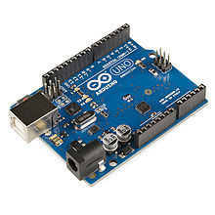

ARDUINO
TTH2D3
Mikroprosesor

Slide 2
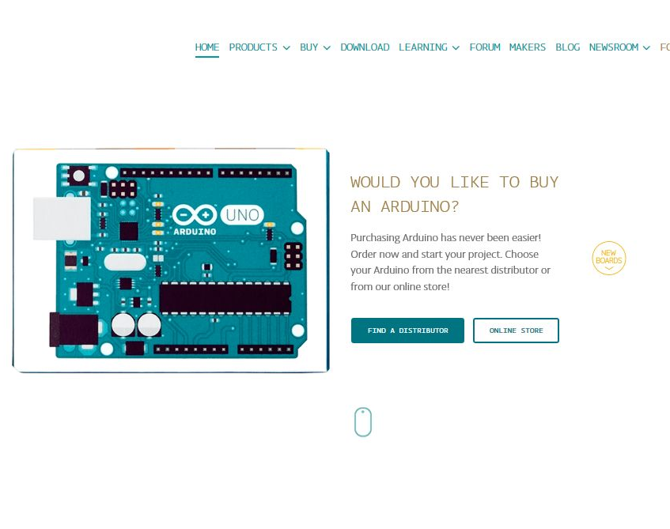
Arduino
http://www.arduino.cc
http://www.arduino.org/products/boards/arduino-uno

Slide 3
Filosofi Arduino
Open source hardware/software prototyping platform
Physical computing: computer that can sense and control physical world compared to ordinary computer (PC)

Slide 4
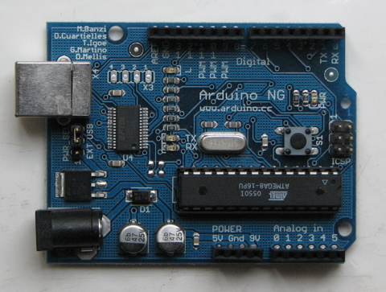
What is Arduino?
Physical computing platform
Open source
“Hardware Abstracted” Wiring Language
USB programmable
Large community
Inexpensive ($31.95 from Sparkfun)

Slide 5
What is Arduino?
Based on ATmega8
w. USB interface
Voltage regulator
The “power” is in:
Standard board design
Wiring language
Open Source

Slide 6
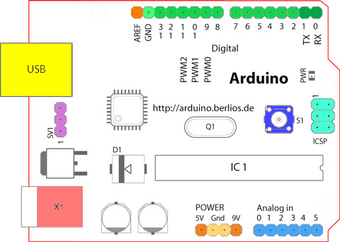
Arduino Board Overview

Slide 7
“Official”
Arduino boards
Arduino shields
Uno
Mega 2560
Mega ADK
Ethernet
BT
LilyPad
Fio
Pro
Nano
Mini
Pro Mini
Ethernet
Wireless SD
Wireless Proto
Motor
Proto

Slide 8
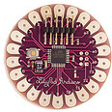
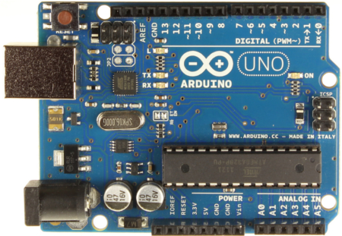
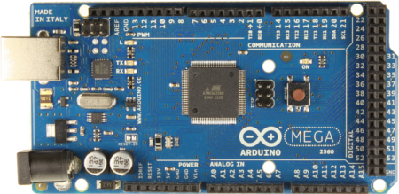
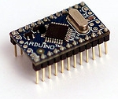
Boards

Slide 9
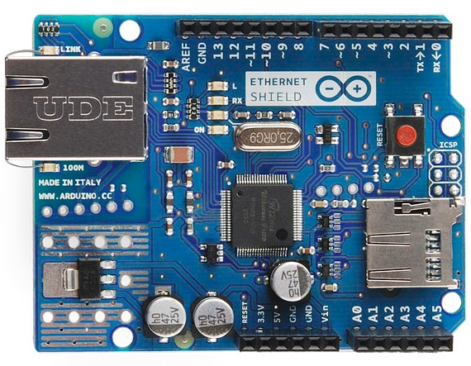
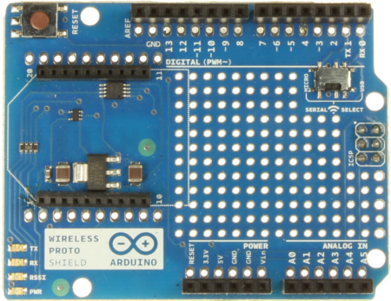
Shields

Slide 10
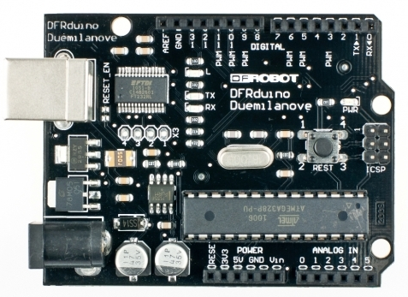
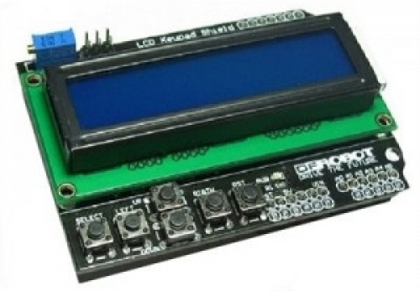
“Unofficial” Boards and Shields
Adafruit
Sparkfun
DFRobot
Itead Studio
etc

Slide 11
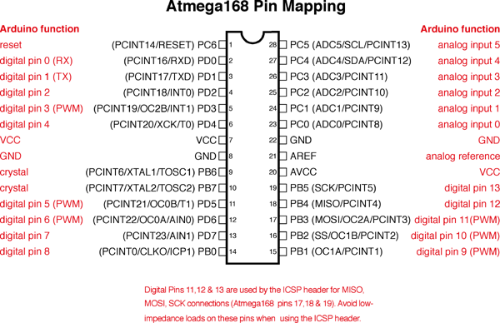
Peta pin
Complete schematic
Atmel ATmega328P datasheet

Slide 12
Physical layout

Slide 13
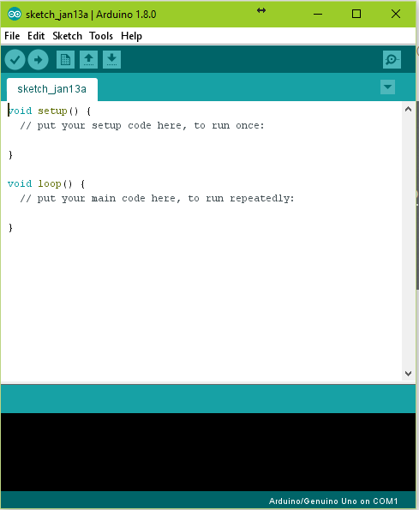
Lingkungan pengembangan
Arduino programming language berdasarkan Wiring (http://wiring.org.co)
Arduino development environment berdasarkan Processing (http://www.processing.org)
Source code = Sketches
Sekilas introduksi

Slide 14
“Official”
Taman bermain (playground)
http://playground.arduino.cc/
Learning
https://www.arduino.cc/en/Guide/HomePage

